Slide 1
Basics of ICP Monitoring
Online Supplemental Reading
Andrew Nguyen, M.D.

Slide 2
Disclosures
None

Slide 3
What is ICP?
Intracranial pressure (ICP)
Normal value 0-15mmHg
But the intracranial vault is large and has tissue of varying composition and density
We can only measure ICP at one spot; is that spot the same throughout the intracranial vault?
  Key assumption intrinsic to management, so important to recognize when it’s not valid
  Same consideration when we measure any value (e.g. PbtO2)– is the measurement in a ”normal” area relevant when the “abnormal” injured area is affected?
  Conversely, if we treat based on the “abnormal” injured area, are we going to damage the “normal” area as a result?
Elevated ICPs ≠ herniation! You can get one without the other

Slide 4
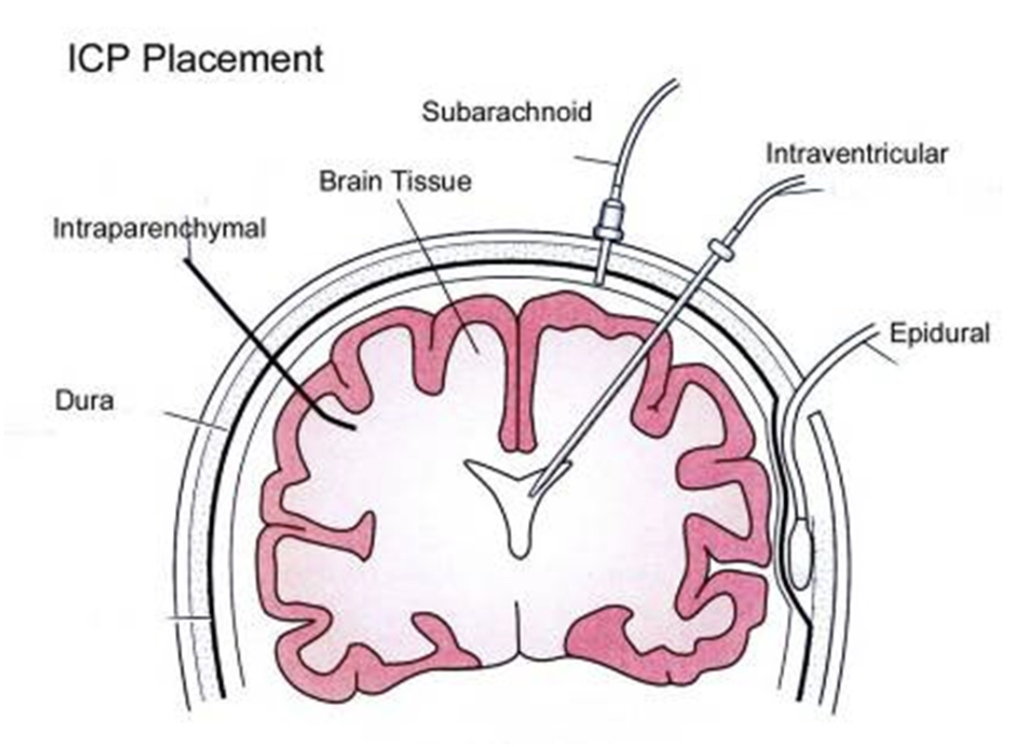
Where can we measure ICP?
Epidural
  Diagnostic
  Not actually used
Subarachnoid
  Diagnostic
  Not actually used
Intraparenchymal
  Diagnostic
  Routinely used, mainly for severe TBI
Intraventricular (aka with an EVD)
  Diagnostic AND therapeutic
  Routinely used across multiple pathologies
Morrison et al. 2023

Slide 5
How do we pick which method?
Depends on whether we also need some therapeutic value
  CSF drainage can be very important (think about Monro Kellie), and only an external ventricular drain (EVD) can accomplish this
For severe TBI, standard of care is to monitor ICPs (see separate talk on TBI), whether with an intraparenchymal monitor or EVD
  BOOST-3 trial (brain tissue oxygenation + ICP monitoring vs. ICP monitoring alone) is assessing whether management based on PbtO2 in addition to standard of care will improve 6-month functional outcome; simultaneous EVD placement is also allowed
Both can be done at the bedside with a small burr hole

Slide 6
How does ICP monitoring work?
Intraparenchymal monitor provides continuous ICP measurements (strain gauge sensor)
EVD can only transduce an ICP when the fluid column (pushed by ventricular fluid) reaches the sensor
  This can only happen when the system is “clamped” → no CSF will drain, but you’ll get a measurement
  Be careful not to clamp the system for too long if they’re dependent on drainage (don’t stare at the monitor too long!)
  Most of the time, the EVD will be “open” (no ICP measurement, but will drain whenever ICP exceeds the level at which the EVD setup is set), and nurses will clamp the EVD for a minute every hour to record the value

Slide 7
What result do we get with ICP monitors?
Look at the monitor to identify the number, measured in mmHg, but be aware of whether it’s real (if EVD, it needs to be clamped, otherwise it’s an artifactual number)
A waveform is also shown, and this can provide some information about cerebral compliance
  Compliance: change in volume over change in pressure

Slide 8
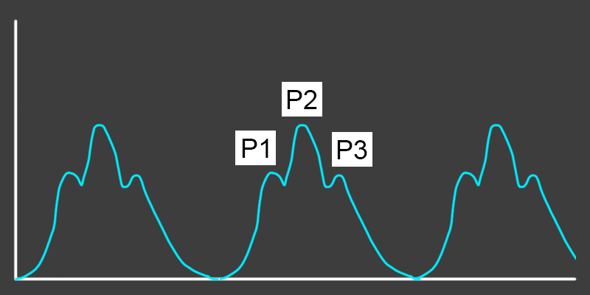
What result do we get with ICP monitors?
ICP waveform:
  P1: influx of arterial blood (this is the first peak on a normal arterial line tracing)
  P2: reverberation of this pressure across the parenchyma; result of their compliance
  P3: dicrotic wave, caused by sudden closure of the aortic valve
  Normal: P1 > P2 > P3
  Impaired compliance: P2 > P1 and P3
  (shown here)

Slide 9
References
Morrison C, Bhalla P, Tran DS, Ruzas CM, Qualls S. Intracranial Hypertension and Herniation. ENLS Version 5.0 (updated 01 Aug 2023).

